Slide 1
Non-Gaussian State Simulation
Qi

Slide 2
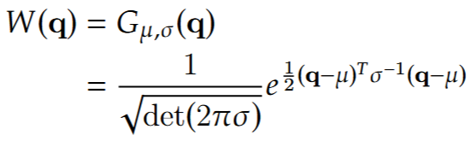
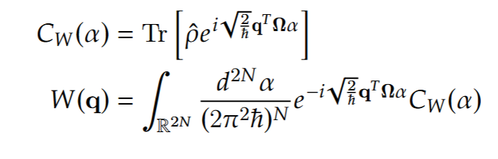
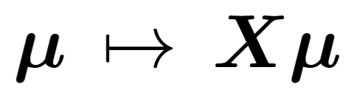
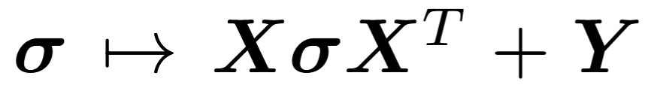
Motivation
Simulation is useful
Gaussian states are awesome
Non-Gaussian operations are necessary (Kerr Gate, PNRD, etc.)
Pretty Wigner function graphs
Gaussian States | Non-Gaussian states
Requires Covariance matrix σ Displacement vector q | Requires Density matrix ρ

Slide 3
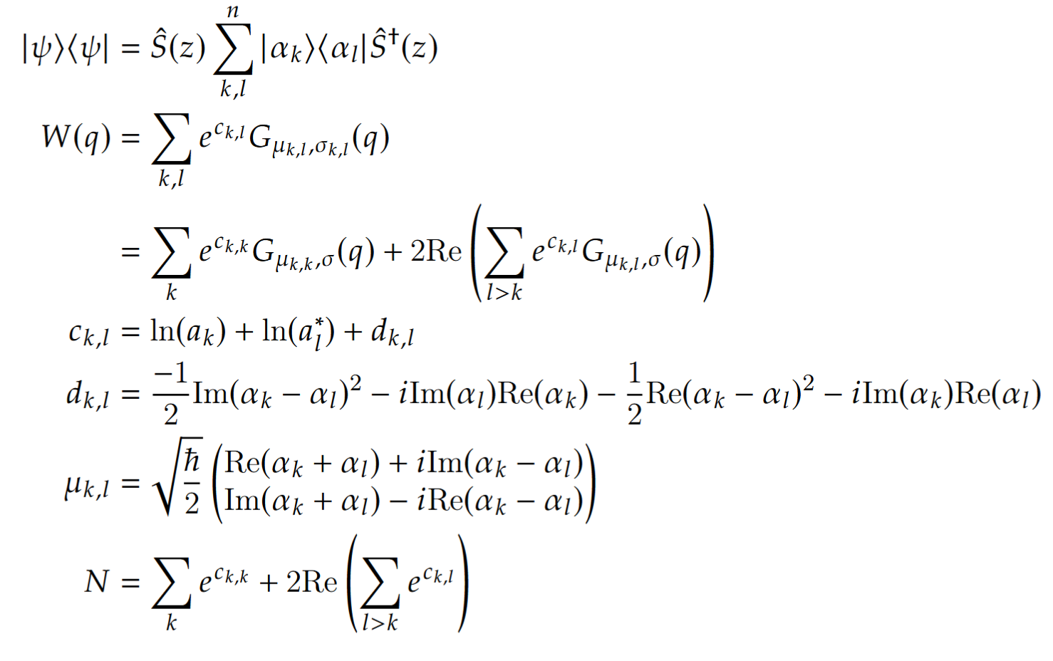
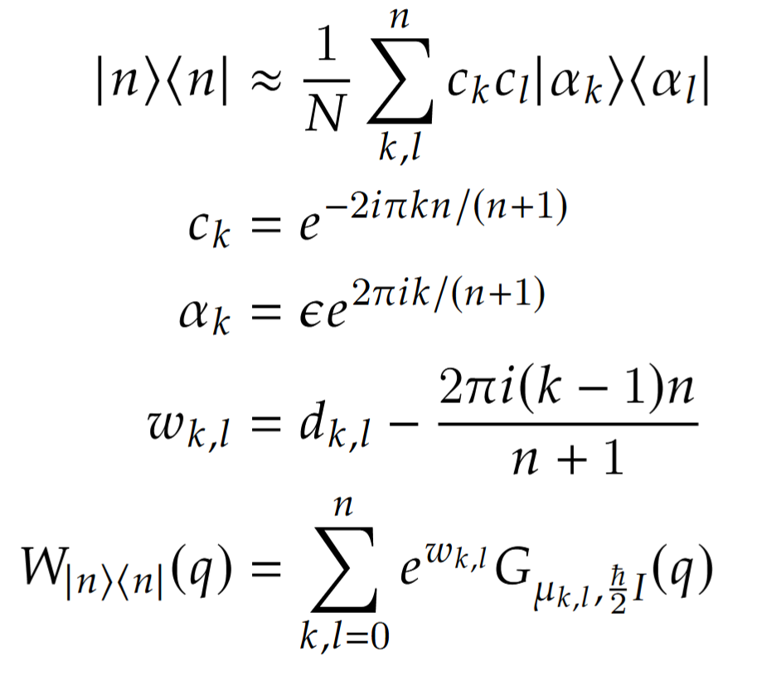
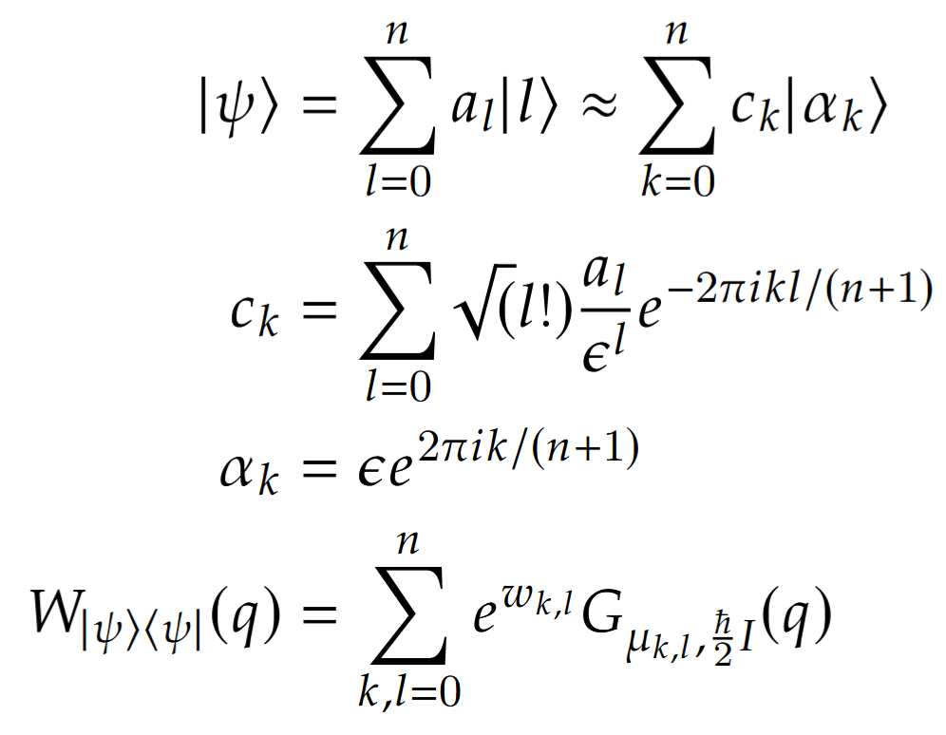
Math: Transforming the states
Superposition of Fock states as a superposition of Gaussian States
Superposition of Gaussian States
Fock state as a superposition of Gaussian States

Slide 4
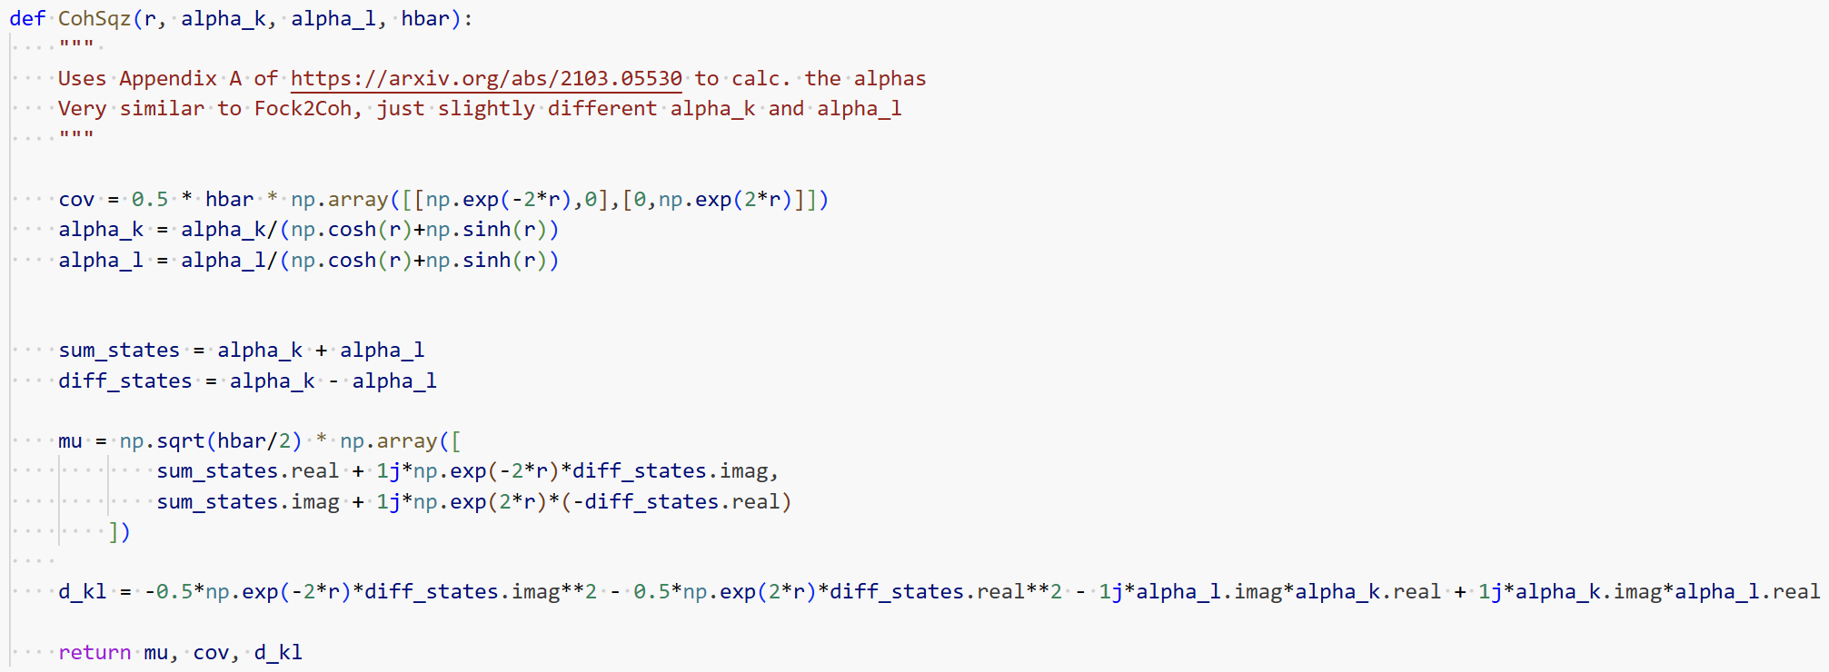
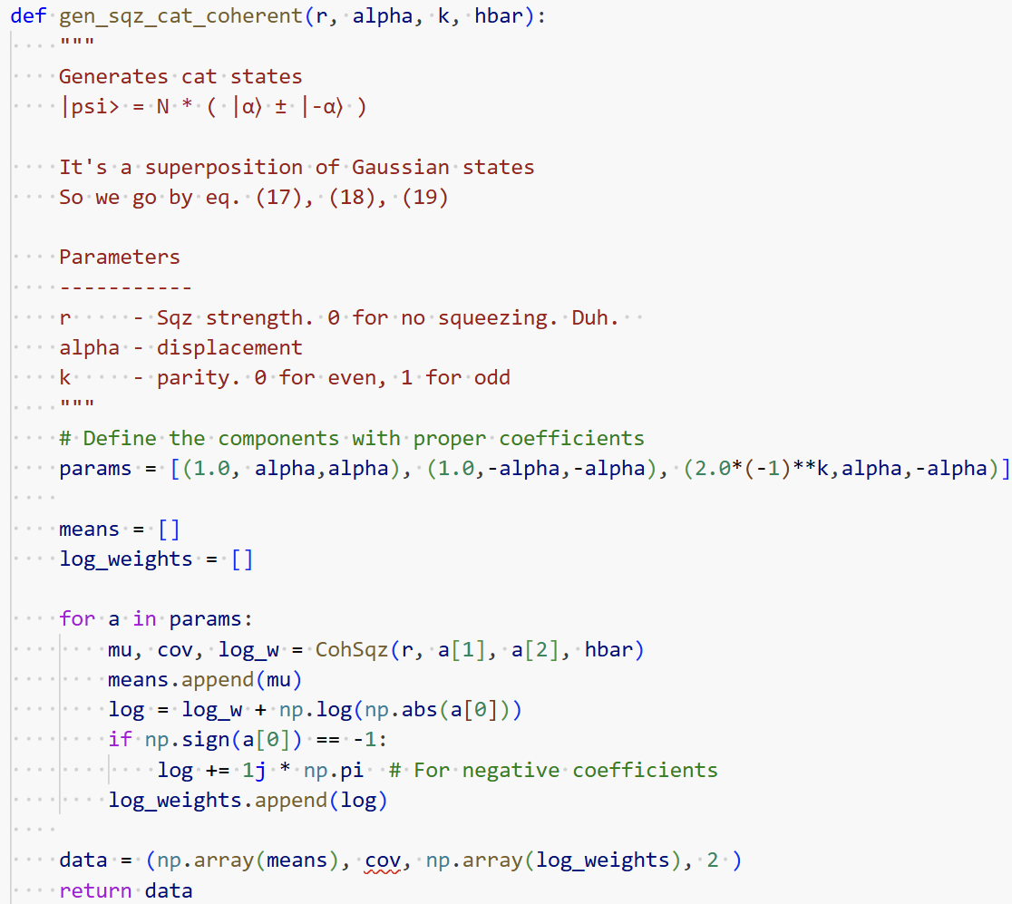
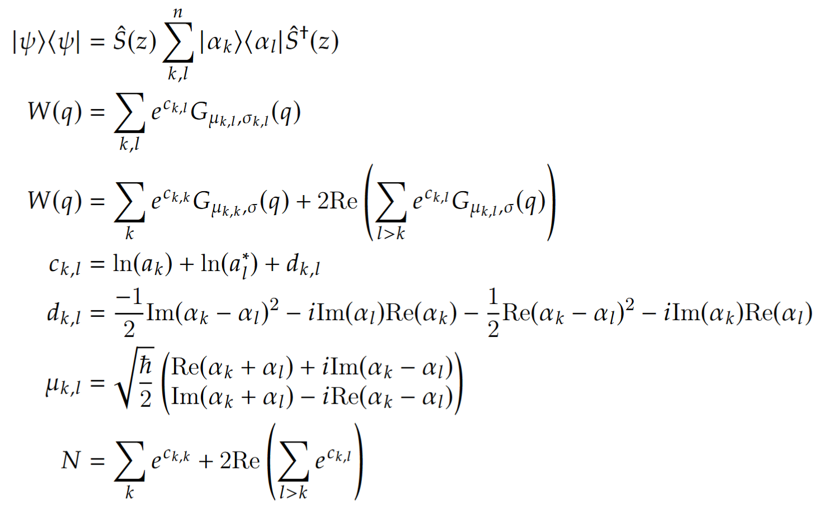
Implementation: Transforming the States
Superposition of Gaussian States (Cat States)

Slide 5
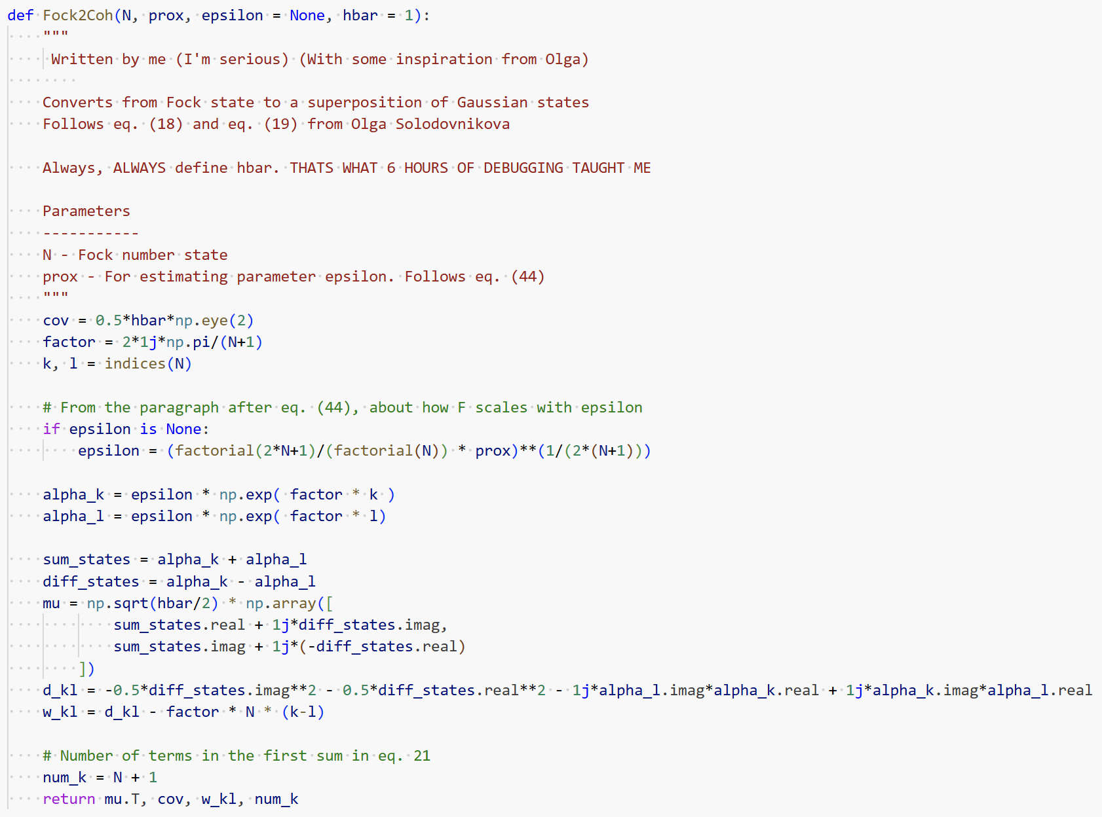
Implementation: Transforming the States
Fock State to Superposition of Gaussian States

Slide 6
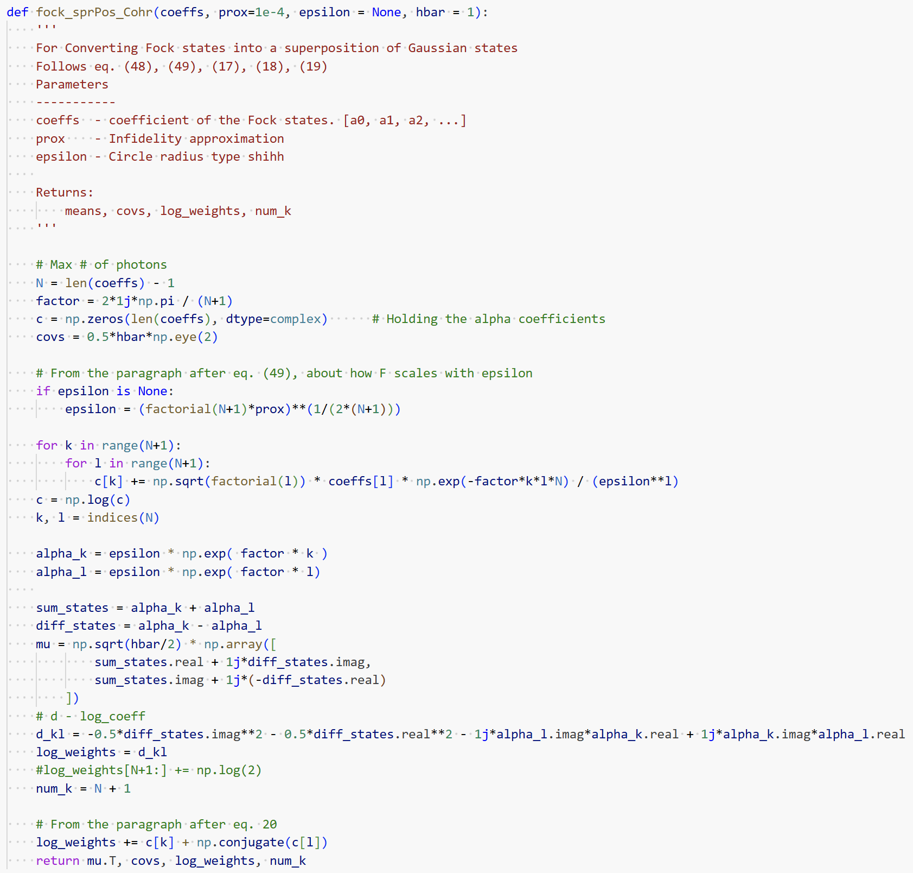

Implementation: Transforming the States
Superposition of Fock States to Superposition of Gaussian States

Slide 7
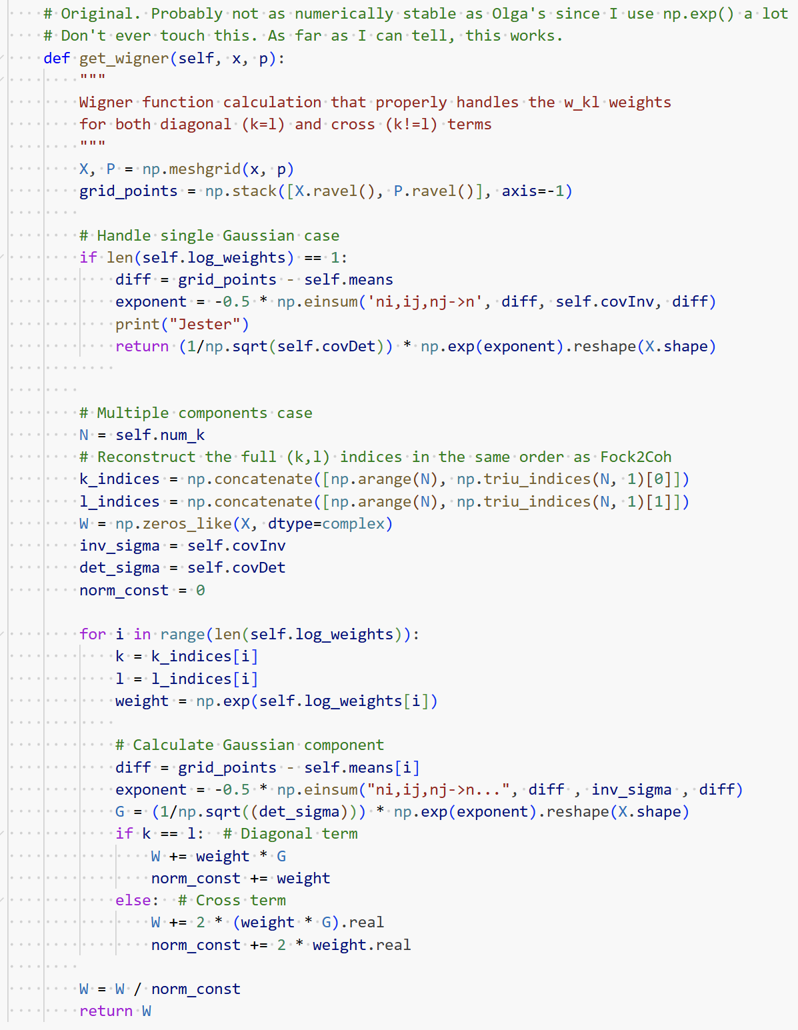
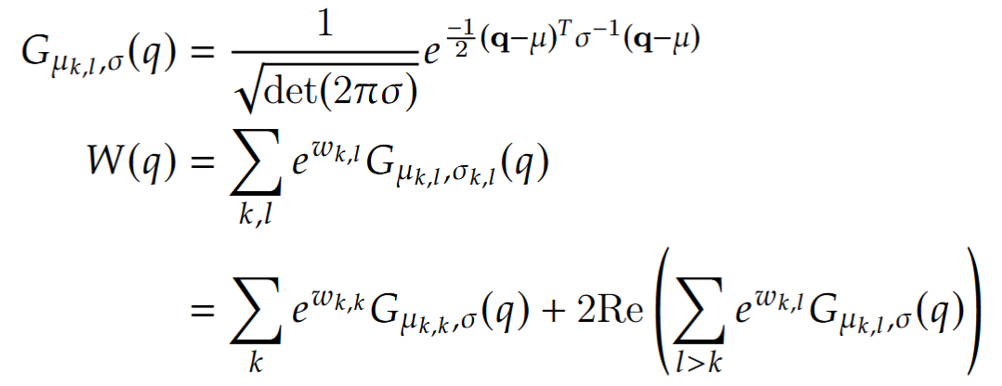
Implementation: Calculating Wigner

Slide 8
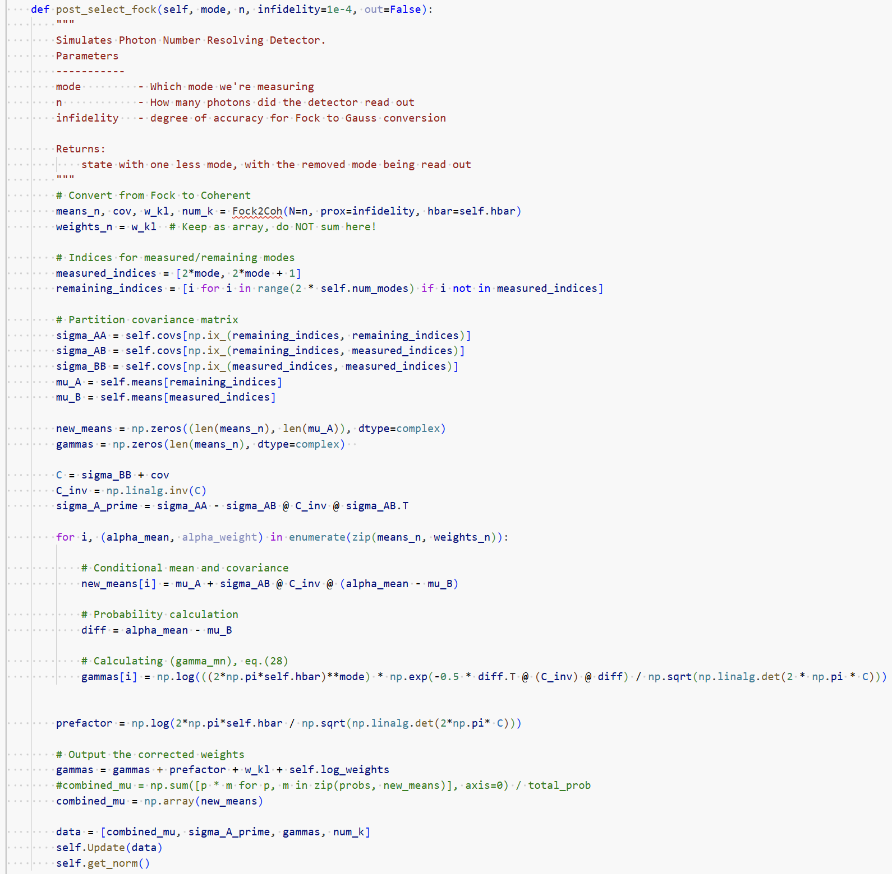
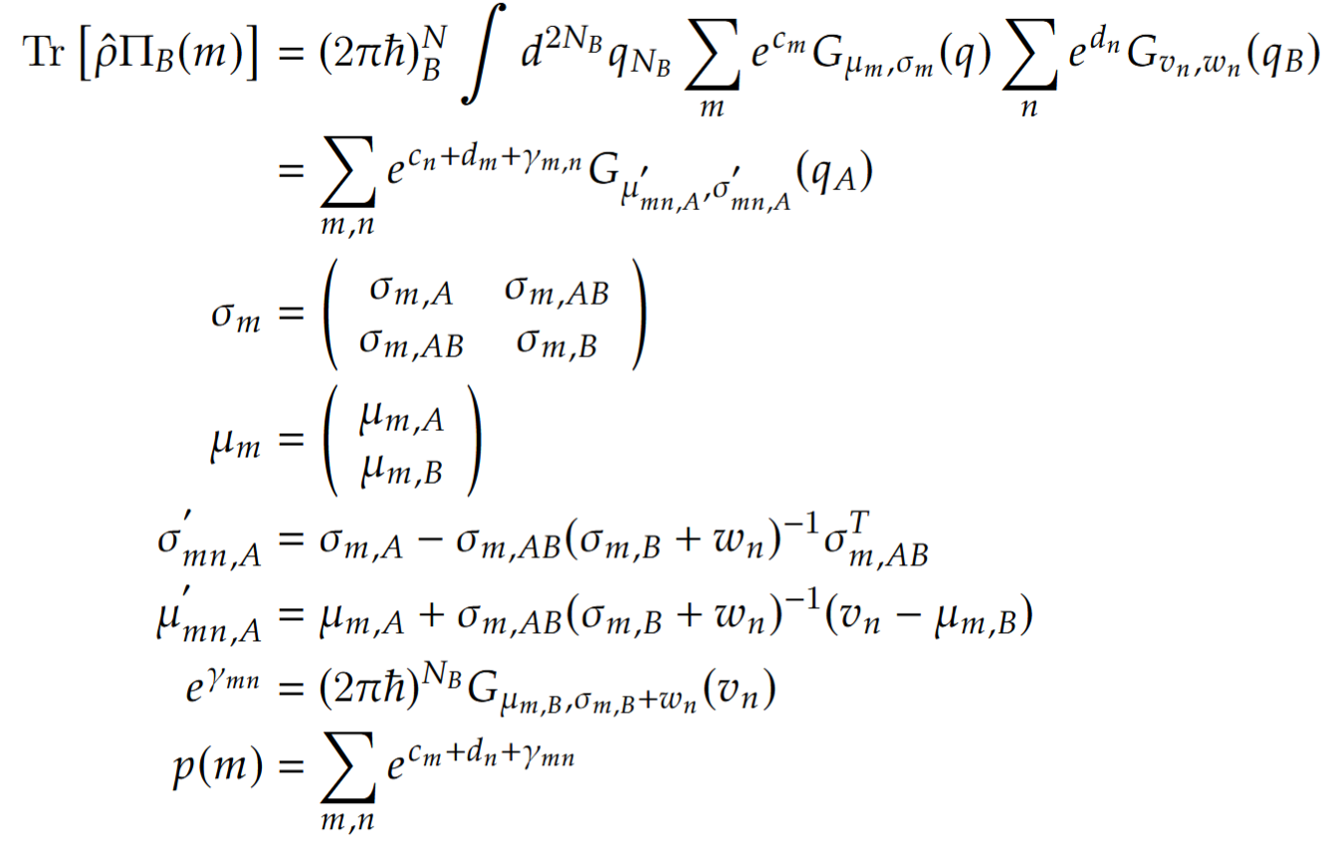
Implementation: Photon Number Resolving Detector

